Slide 1
Machine Learning Piyush Dave

Slide 2

What is Machine Learning?

Slide 3
Machine Learning is…
learning from data
no explicit programming
discovering hidden patterns
data-driven decisions

Slide 4

Machine Learning is…
…learning from data

Slide 5
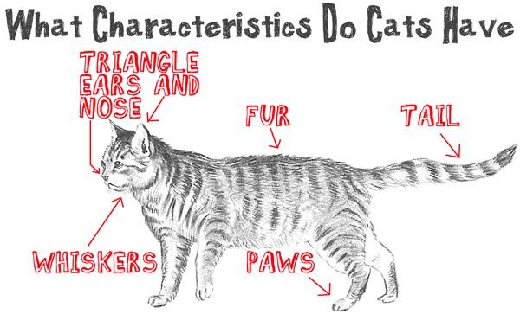
Machine Learning is…
… learning from data
… no explicit programming

Slide 6

Example Application of Machine Learning
Credit card fraud detection

Slide 7
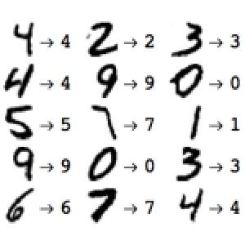
Example Application of Machine Learning
Handwritten digit recognition

Slide 8

Example Application of Machine Learning
Recommendations on websites

Slide 9
More Applications of Machine Learning
Targeted ads on mobile apps
Sentiment analysis
Climate monitoring
Crime pattern detection
Drug effectiveness analysis

Slide 10

Machine Learning Models
Learn from data
Discover patterns and trends
Allow for data-driven decisions
Used in many different applications

Slide 11
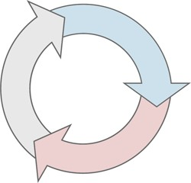
REPORT
ACQUIRE
PREPARE
ANALYZE
ACT
Iterative process

Slide 12

ACQUIRE
PREPARE
ANALYZE
REPORT
ACT
Deployment
Evaluation
Modeling Data Preparation
Data Understanding Business Understanding

Slide 13
Categories of Machine Learning Techniques
Regression
Association Analysis
Cluster Analysis
Classification

Slide 14
Categories of Machine Learning Techniques
Regression
Association Analysis
Cluster Analysis
Classification
Supervised Machine Learning
Unsupervised Machine Learning

Slide 15
Classification

Slide 16
Regression

Slide 17
Cluster Analysis

Slide 18
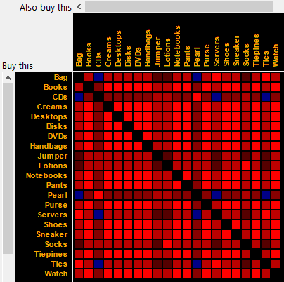
Association Analysis

Slide 20


Main Challenges of Machine Learning

Slide 21
Insufficient Quantity of Training Data
Simple problems you typically need thousands of examples
Complex problems such as image or speech recognition ,you may need millions of examples

Slide 22
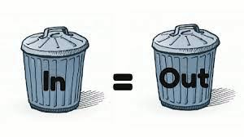
Irrelevant Features
garbage in, garbage out

Slide 23
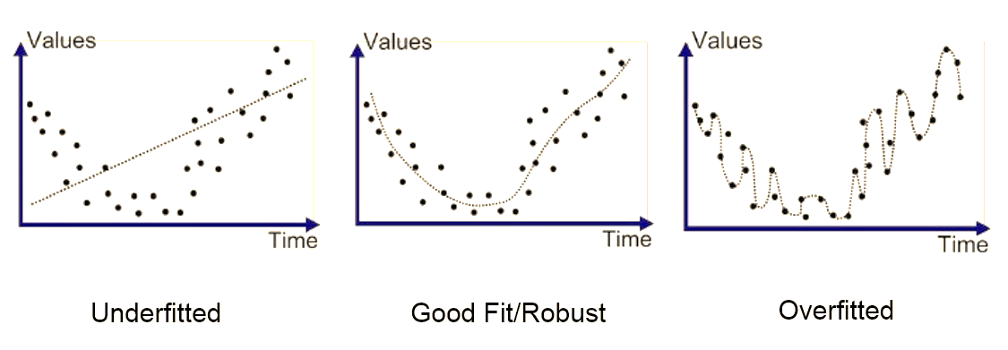
Overfitting and Underfitting the Training Data

Slide 24

Testing and Validating

Slide 25
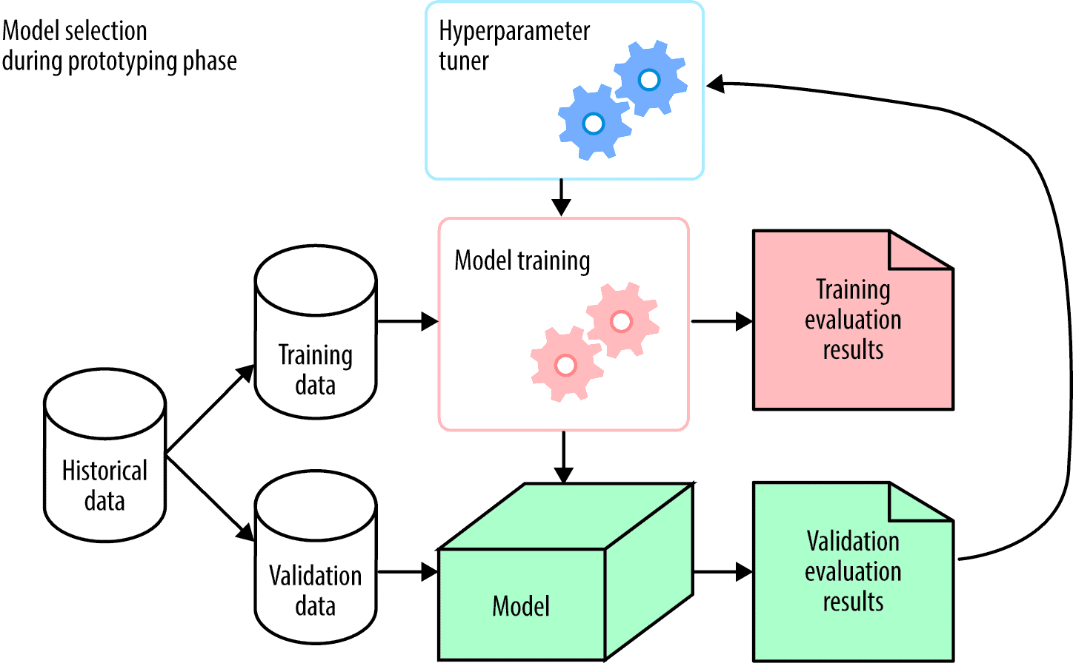
Hyperparameter Tuning and Model Selection

Slide 26
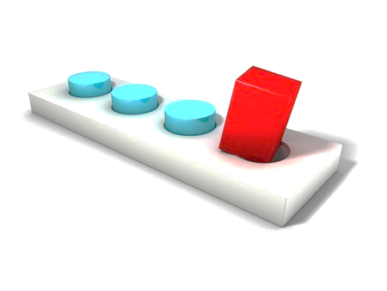
Data Mismatch

Slide 27
No Free Lunch Theorem in Machine Learning
A model is a simplified version of the observations. The simplifications are meant to discard some data. However, to decide what data to discard and what data to keep, you must make assumptions.
For example, a linear model makes the assumption that the data is fundamentally linear and that the distance between the instances and the straight line is just noise, which can safely be ignored.
In a famous 1996 paper,11 David Wolpert demonstrated that if you make absolutely no assumption about the data, then there is no reason to prefer one model over any other. This is called the No Free Lunch (NFL) theorem.
For some datasets the best model is a linear model, while for other datasets it is a neural network. There is no model that is a priori guaranteed to work better (hence the name of the theorem).
The only way to know for sure which model is best is to evaluate them all. Since this is not possible, in practice you make some reasonable assumptions about the data and you evaluate only a few reasonable models.
For example, for simple tasks you may evaluate linear models with various levels of regularization, and for a complex problem you may evaluate various neural networks.

Slide 28


How to Learn Math for Machine Learning?
Step by Step Guide

Slide 29
Benefits to Know Mathematics before starting ML
Accuracy, Training Time, Model Complexity, Number Of Parameters and Number of Features
Under-fitting And Over-fitting
Parameter Settings And Validation Strategies
Right Confidence Interval And Uncertainty

Slide 30
4 Topics are require for ML
Linear Algebra
Probability Theory and Statistics
Multivariate Calculus
Optimization Methods

Slide 31
Topics to Learn in Linear Algebra
Matrix
Vectors

Slide 32
Topics for MultiTopicsvariate Calculus
Functions of several variables
Derivatives and gradients
Step function
Sigmoid function
Logit function
ReLU (Rectified Linear Unit) function
Cost function

Slide 33
Topics to Learn to Probability & Statistics
Mean, Median, Mode, Standard deviation/variance, Correlation coefficient and the covariance matrix
Probability distributions (Binomial, Poisson, Normal)
Baye’s Theorem (Precision, Recall, Positive Predictive Value, Negative Predictive Value, Confusion Matrix, ROC Curve)

Slide 34
Topics to Learn to Optimization Methods
Cost function/
Objective function
Likelihood function
Error function
Gradient Descent Algorithm and its variants

Slide 35
Thank You

